Slide 1
Predicting houseprices for private residential properties

Slide 2
TABLE OF CONTENTS
01
02
03
05
04
Why private residential properties ?
Dataset used for analysis
Exploratory Data Analysis
Modelling and errors
Future improvements

Slide 3
1. Why Private residential properties?
It is considered as an asset under our portfolio
2. We want our properties to appreciate overtime and not depreciate.
3. Important information for homeowners and private investors dealing with real estate

Slide 4
2. Dataset used for analysis
Dataset download from URA website into csv format
2. Dataset consist of 9728 rows and 15 columns
3. URL : https://www.ura.gov.sg/realEstateIIWeb/transaction/search.action

Slide 5
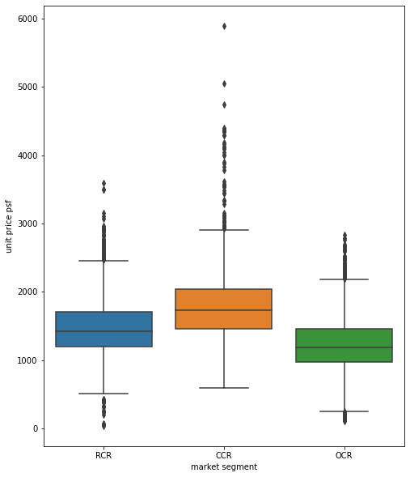
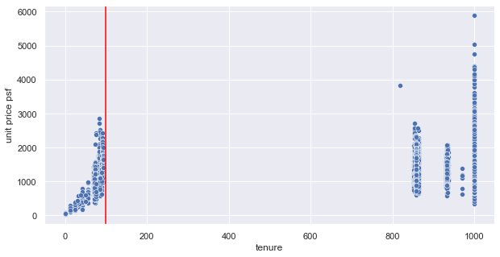
3. Exploratory Data Analysis
Features check was done, using y to be unit price psf
Such as market segment, postal district, and tenure can affect the model greatly, alot of outliers was detected

Slide 6
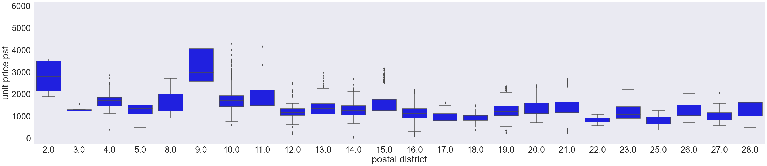
3. Exploratory Data Analysis
3. Postal District has huge amount of outliers, especially for district 10

Slide 7
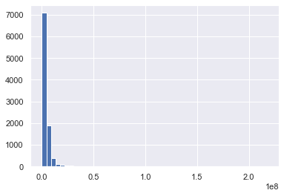
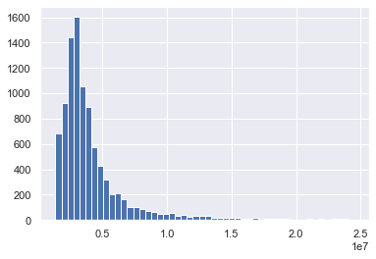
3. Exploratory Data Analysis
4. Most of the data are skewed to the left which means there is a lot of outliers on the higher price side
5. Without 5% removal and with 5% removal

Slide 8
4. Modelling and errors
Selection of y was price per psf and total price
Price per psf and total price cannot be a feature of each other, data leakage will occur
Linear Regression, Xgboost Regressor (overfitted) and RandomForestRegression (overfitted)
No overfitting for linear regression, however accuracy was bad

Slide 9
4. Modelling and errors
Change y = price, instead of price per psf
Removing of outlier psf previously, removal of highest 2.5% and lowest 2.5% of price (merged_houseP)
Linear Regression and XGboost shows no overfitting
RMSE was $1100494 and $860700 respectively

Slide 10
4. Modelling and errors
Split up tenure of <=99years and >99 years (freehold)
Did a model each for different tenure, the skewness makes the previous model difficult to predict accurately
For 99years RMSE is $713246 with 2.7% overfit, there were only 1470 rows in tenure <=99years
For freehold RMSE is $866714 with 2.1% overfit, there were 8020 rows in tenure

Slide 11
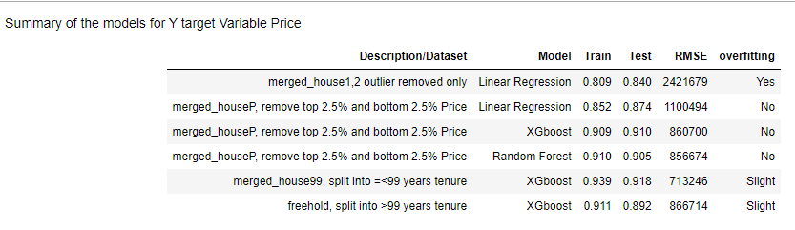
4. Modelling Summary table

Slide 12
4. Modelling and errors
A calculation of mean price was done for <=99years and >999 years
For <99years, the percentage error for the cost using RMSE and mean price is 27%
For >999 years, the percentage error for the cost using RMSE and mean price is 20%

Slide 13

Future Improvement
1. Possibility of getting more data of sales history
2. A property price(e.g. inflation) to fit into the model.
Majority of the data for private residential properties lies in the freehold category making 99 years properties difficult to predict
With a inflation curve or features, the date can be used as a feature to tune the model more isntead of dropping it

Slide 14
THANKS
Does anyone have any questions?
Github: https://github.com/huangjx1/Capstone-Final-

